Slide 1

Improper Waste Disposal and its impact on Environment and Health.
Dr Aruna Sao
Asst Professor, Chemistry
S D N Govt College, Arjunda
Asst Professor

Slide 2
Introduction
Waste Disposal : Waste disposal means removing, scrapping, recycling, or eliminating unwanted materials is called waste disposal.
In our daily lives, we observe many piles of garbage which are sometimes left open to the environment.
Open dumping is the most common method of waste disposal in India which releases toxic fumes and smoke that are harmful to the environment and cause a lot of problems in the long term.
Let's understand the Waste Disposal, methods, projects, Services, and many more in detail.

Slide 3
Types of Wastes
Municipal Solid Waste (MSW)
Industrial Waste
E-waste
Hazardous Waste
Medical Waste
Radioactive Waste
Causes of Improper Waste Disposal
Lack of infrastructure
Insufficient awareness
Lack of funding
Poor waste management policies
Socio economic issues
Limited Equipment

Slide 4
Need of Waste Segregation
Improper management of waste results in higher pollution in landfills, and most populated countries like India usually generate higher waste per annum.
Waste Segregation is important for waste management. We create varieties of waste in our day-to-day lives and if we do not sort out those waste into separate categories or dustbins; it will be difficult to properly manage or dispose of.
We, as responsible citizens need to manage our waste properly by practicing proper waste segregation.

Slide 5
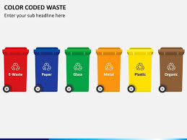
Colour Code for Waste Disposal
Colour coding at the source itself helps in separating the waste for waste disposal. It helps in decreasing the hazards & handling & disposal costs.
The colour codes for waste disposal varies from country to country.
It may also be different for plastics, recyclables, metals, glassware, radioactive items, etc.
They need to be separated as per the recycling needs.

Slide 6
Colour Code for Waste Disposal
1. Yellow : Biomedical waste, Syringes, Cotton Bandages clinically highly infectious : pathogenic waste. Body fluids or medicinal fluids which infect PPE kits & garments.
2. Orange :Concrete, Bricks, Wood, Asphalt, Tiles, Plasterboard, Metals, Rubbre, and so on.
3. Black :Plastic Packaging, Rubber, Old Clothes, Diapers, Pet Waste, and for trashing common household items, neither recycled nor composted. non-biodegradable items.
4. Green Bins :made for organic waste that is biodegradable such as vegetable waste, fruit waste, garden waste, animal waste, and more.
5. Red : Hazardous, medical anatomical waste , all body part surgical treatments., Chemicals, Pesticides, radioactive wastes. This needs to be incinerated.
6. White : Old Computers, Laptops, Mobile Phones, Televisions, Headphones, and other electronic items and their parts, Recyclable.
7. Blue : non-hazardous solid waste, Recyclable Waste,regular pills, medication & pharmaceuticals.

Slide 7
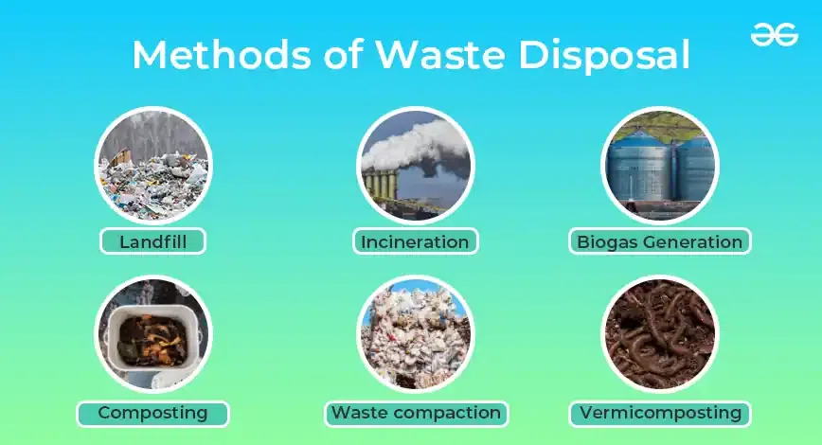
Methods of Waste disposal
The various methods of solid-wastes disposal are :
• Land filling,
• Incineration,
• Pulverization,
• Composting,
Biogas Generation,
Vermicomposting,
Waste Compaction
• Pyrolysis, and
• Disposal into sea.

Slide 8
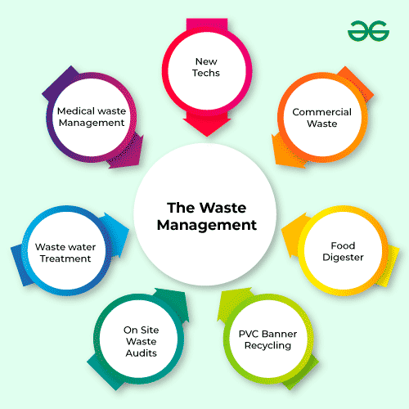
Waste Management

Slide 9
E - Waste
The electronics industry is the world's largest and fastest‐growing industrial sector. Due to the wide- spread of new gadgets there is a huge segment of electrical waste on the planet.
Sources of E waste-
Due to the high demand of electronic waste especially mobile phones, computers, solar cells, electric vehicles and laptops, the economic growth of IT sectors is growing exponentially in high volumes which resulted in a good economic rate of the country.
To introduce new technology to the market, the public and private sectors are replacing obsolete electronic products with new ones,
resulting in an increase in E‐waste garbage. Household appliances, small and big enterprises, PC manufacturers, institutions, and other industries create domestic E‐waste.

Slide 10
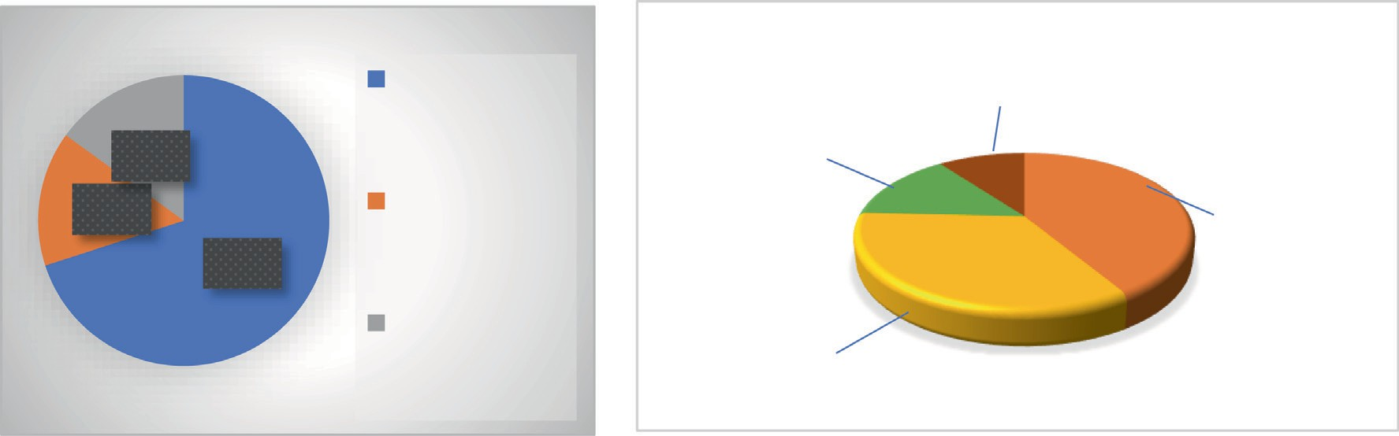


Sources of E Waste
Business sector consists of government departments, public and private sectors, MNCs, etc. This sector is the main benefactor for the E‐ waste production.
As per the survey, they are subjected to around 79% of total installed PC’s which is the highest in all the sectors.
around 1050 million tonnes of these peripheral devices being trashed every year ( IC chips, motherboards, cathode ray tubes (CRTs) etc, )
no one knows how much E‐waste is produced or how much is imported and exported.
getting accurate statistics on recycled E‐waste by various sectors is problematic.
household contributes the less share in E‐waste production. around only 20–21%

Slide 11
E Waste production in India
India is the world's third largest contributor, with roughly 3.2 million metric tonnes of rubbish created every year, trailing only China and the United States.
Prime Minister Narendra Modi talked in December 2020 on the importance of maximising the use of electronic devices.
He announced an initiative dubbed 'Garbage to Wealth' in August 2021, which focuses on putting waste to better use.
According to the Central Pollution Control Board of India's 2020 reports, about 1,014,961 tonnes of E‐waste were created in the years 2019 and 2020.

Slide 12
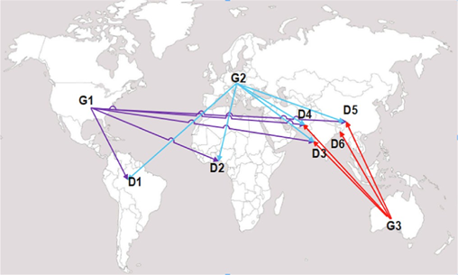
Generator and Dumping Countries
In G shows the generating or origin country
whereas, D shows the exporting or dumping country
of E‐waste.
G1, is North America,
G2 is Western Europe and
included some part of Eastern Europe as well,
G3 is Australia,
D1 is Brazil,
D2 shows some parts of Ghana, Nigeria, Ivory Coast,
D3 is Thailand,
D4 is India,
D5 is China and D6 is Vietnam.

Slide 13
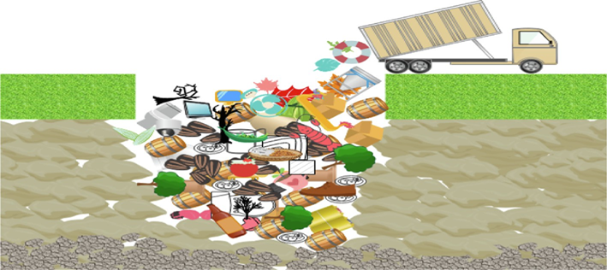
Various recycling methods for electronic waste
Landfilling
Various sectors implemented so many
techniques/ methods for the recycling of
electronic trash.
E‐waste breakdown at landfills is particularly
labour‐intensive and takes a long time.
•Landfills take a diverse range of waste kinds and mix them together.
Furthermore, cadmium and mercury are known to be produced in a number of ways, including by burning landfill gas.
The E‐waste factory's product mix implies that environmental (long‐term) dangers, such as dental fillings in safe land, cannot be overlooked.

Slide 14
Incineration process
Pyrolysis, which happens in the absence of oxygen and results in the transformation of materials into gases, oils, and charcoal, as well as the ashes that remain after the combustion process is complete, is also dangerous.
On the African continent, as well as in India's neighbouring countries, incinerating electrical waste is a common practice.
When a plastic or PVC motherboard is heated, PCAs, PCDDs, and PCDFs, as well as carbon monoxide gas, SO2, and NO2, are released into the air, releasing a poisonous gas that is harmful to human health and the environment
Smoke can also include trace amounts of heavy metal oxides such as antimony, lead, thallium, arsenic, copper, manganese, mercury, and nickel.

Slide 15
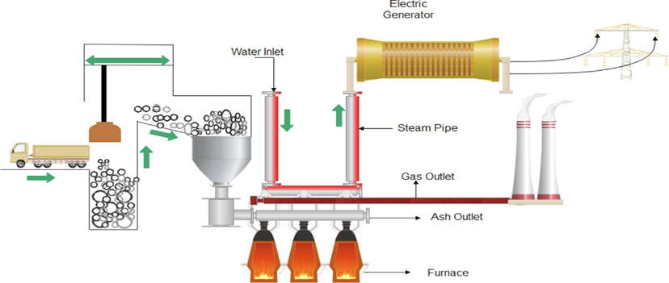

Slide 16
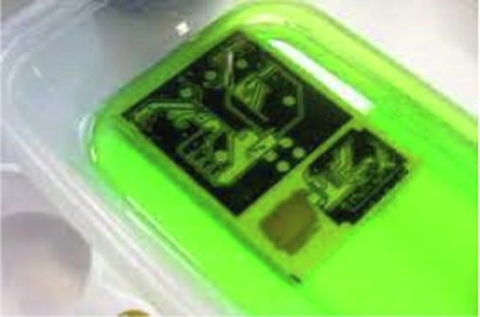
Acid Bath
To remove copper, an acid bath is employed, which
entails soaking the circuit board in sulfuric acid for
around 10–15 h to liquefy metals like copper.
Lead was also dissolved and silver and gold were
removed using acid treatments.
Biological procedure for E-waste
The utilization of biological techniques of metal extraction in steels like Au and Cu has emerged as a unique innovation.
A promising new technique involves using microbes to break down metallic ores and electronic waste.
Bio‐metallurgical methods transform metal directly from ores, concentrates, and wastes into soluble salts in liquid media.

Slide 17
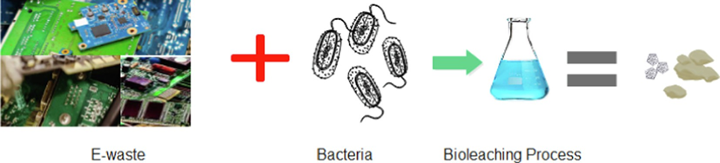
Bioleaching Process
Bio metallurgy is a single field that combines biotechnology and metallergy.
Ore bioleaching is referred to as “direct” and “indirect” bio‐ oxidation.
Bacteria such as Acid thiobacillus ferroxidase, Leptospiral ferroxidase, and Acidithiobacillus thiooxidans are examples of bacteria that extract metals from this sort of waste.
Biological method for e-waste disposal.

Slide 18
Impact on human health and environment
Dioxin poisoning in the air has resulted in human exposure levels that range from 15 to 56 times the WHO's recommended maximum intake.
Dioxin levels were found to be raised in human milk, placentas, and hair, indicating that dioxins are being ingested in significant quantities by humans through the air, water, or food to pose a serious health risk
Many illnesses are affecting individuals as a result of electronic waste, including indigestion, inhalation, and most notably skin contact concerns.
The consequences of improper management of E Waste leads to landfills, releasing of toxic chemicals, impacting earth’s surface and most importantly human health.

Slide 19
Impact on Soil, Air and land
Diseases like cancers and tumours especially chronic diseases are at high risks in human beings as the E‐waste releases very fine particles which are hard to handle, creates numerous health issues to humans and animals.
When heavy metals are present in the soil, crops are more vulnerable to absorbing these toxins, which can result in a range of illnesses and reduce agricultural productivity. heavy metals from E‐waste, such as mercury, lithium, lead, and barium, seep further deeper into the earth, finally reaching groundwater.
After reaching groundwater, these heavy metals eventually make their way into rivers, ponds, and lakes. These routes produce acidification and toxification in the water, which is detrimental to animals, plants, and communities even if they are kilometres away from a recycling facility. Even finding safe drinking water becomes tough

Slide 20
Indian scenario of E-waste management
India has been the first country in South Asia to have a special E‐ waste law in place since 2011.
The E‐Waste Handling Rules created criteria for garbage transportation, storage, and recycling, as well as the concept of extended producer responsibility (EPR)
. EPR is a well‐known policy tool that requires electronic device producers to take financial and physical responsibility for handling their products' disposal once they have reached the end of their useful lives.
In 2016, the regulations were updated to establish a 'Producer Responsibility Organization' (PRO) to help with electronic trash collec- tion and recycling.

Slide 21
Conclusion
The e-waste challenge is a pressing issue that requires
immediate attention and action.
By embracing circular economy principles, implementing effective policies, and fostering collaboration among consumers, manufacturers, and recyclers, we can mitigate the environmental and health impacts of e-waste.
Together, we can pave the way for a more sustainable future, where electronic devices are responsibly managed throughout their life cycle, minimizing waste and maximizing resource recovery.

Slide 22
Slogans for Waste Disposal
In order to create awareness about waste disposal methods, from time to time various slogans are used to increase the awareness of public about waste management. The following are the Slogans for the waste disposal:
"Save things or waste, it's your choice."
"Increase greenery by recycling waste"
"Recycle your trash or trash your Earth."
"Think before your trash"
"Waste isn’t waste until we waste."
"Be a recycler, be a saver."
"Reduce wasting natural resources."

Slide 23
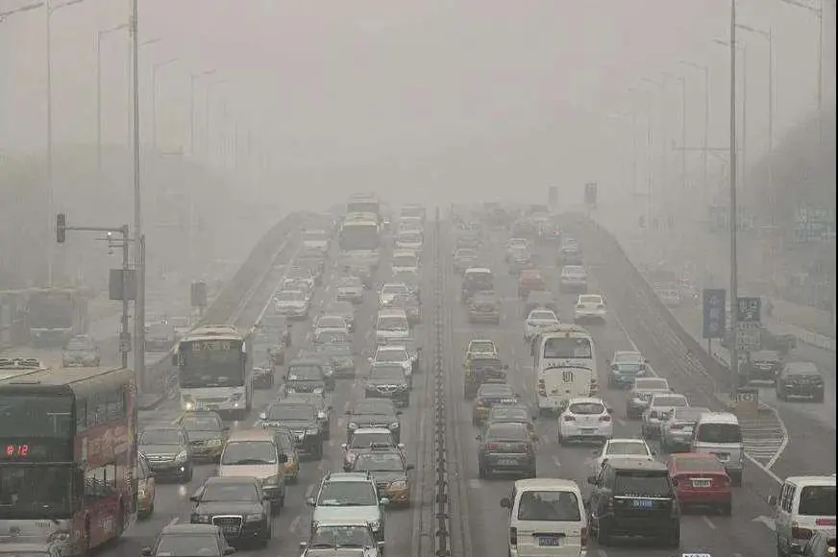
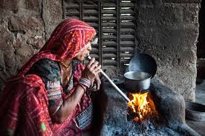
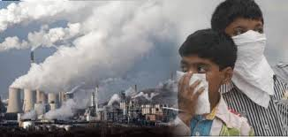
````````Air Quality in India… Ufff Indias polluted Cities

Slide 24
Impact of waste disposal on environment/Climate/health
Soil contamination is the No. 1 problem caused by improper waste removal and disposal. Some wastes that end up in landfills excrete hazardous chemicals that leak into the soil.
Waste that contains hazardous chemicals, such as bleach and acids, needs to be disposed of properly.
Some papers and plastics are burned in landfills, emitting gas and chemicals that hurt the ozone layer.
Waste that releases dioxins are also dangerous and pose a health risk when they diffuse into the air that we breathe.

Slide 25
Case Study: Research Design
A study was conducted at the Sobantu community in the Msunduzi local municipality in the KwaZulu Natal Midlands in South Africa. Sobantu Township had a serious challenge of environmental degradation and pollution since it is located within the proximity of 3 meters of a New England landfill site. The location makes it difficult for the residents to live a healthy life due to odor coming from the landfill site Poor management of catchment areas resulted in the degradation of wetlands within the municipality . Furthermore, the lack of waste collection services
study adopted both open and close-ended questions on a semi-structured questionnaire,
The community members of Sobantu township were randomly selected to participate in the study.
The minimum sample size was determined as 200 using published tables from the estimated population size of 7,448 of the study community.
and this study analysed primary data from 100 respondents .

Slide 26
Data analysis
This study analysed data collected descriptively and inferentially using Statistical Package for Social Scientists (SPSS) software (version 29).
A series of Pearson chi-square tests were applied to gauge the correlation between some demographic variables and some pertinent questions concerning knowledge of the general risks of improper waste disposal and aspects of human health risks related to improper waste disposal.
Qualitative data, in the form of open-ended questions, was also analysed thematically and using descriptive statistics.
Furthermore, the study applied an ordinal regression to assess the cost of clean-up for the municipality.
The results are presented using tables and charts, and a brief explanation and discussion of the results are made.

Slide 27
Data Analysis
applied six chi-squared tests of independence to assess the risks of improper waste disposal by correlating the following variables:
• gender and the question of whether the respondents are aware of improper waste disposal in their community.
• age group and knowledge of the effects of improper waste disposal.
• the level of education and the knowledge of risk posed by improper waste disposal.
• marital status and knowledge of the factors that cause improper waste disposal in the community.
• the employment status of respondents and the most vulnerable to risks of improper waste disposal in their community.

Slide 28
    Human health risk of improper waste disposal
To understand the human health risks posed by improper waste disposal, the study first asked the respondents if they knew of any human health risks caused by improper waste disposal.
Secondly, the study asked the respondents if they had ever noticed any health hazards in and around their dumping area, and the responses were analysed descriptively.
This study applied a chi-squared test to assess the respondent’s answers when asked about information available to communities about the impacts of improper waste disposal.

Slide 29
Improperly waste disposed reported by the study respondents applied to a basic framework for categorizing waste.
Waste categories | Potential risks | Number of responses
Organic Waste: Includes food scraps, yard waste, and other biodegradable materials and contamination | Improper disposal can lead to methane emissions and soil | 9
Inorganic Waste: Non-biodegradable materials like plastics, glass, metals, and ceramics | These can persist in the environment for long periods, causing pollution and harming wildlife | 39
Hazardous Waste: Includes chemicals, batteries, electronic waste (e-waste), and medical waste | These substances can pose serious health risks if not disposed of properly, contaminating soil and water sources | 6
Toxic Waste: Waste containing toxic substances such as heavy metals, pesticides, and radioactive materials | Improper disposal can lead to poisoning, environmental degradation, and long-term health issues | 1
Electronic Waste (e-waste): Discarded electronic devices like computers, TVs, and smartphones | Improper disposal can release harmful chemicals and heavy metals into the environment, posing health risks and polluting soil and water | 12
Construction and Demolition Waste: Includes debris from building materials like concrete, wood, bricks, and insulation | Improper disposal can lead to land degradation, habitat destruction, and pollution of water sources | 4
Biomedical Waste: Waste generated from healthcare facilities, such as used needles, syringes, and expired medicines | Improper disposal can spread diseases and contaminate the environment | 6
Radioactive Waste: Waste containing radioactive materials, often generated from nuclear power plants, medical facilities, and research institutions | Improper disposal can result in radiation exposure, contaminating soil, water, and air | 0
Liquid Waste: Includes wastewater from households, industries, and agricultural activities | Improper disposal can lead to water pollution, harming aquatic ecosystems and human health | 5
Solid Waste: General household and commercial waste that does not fit into other categories. This can include paper, cardboard, textiles, and rubber | Improper disposal can lead to littering, pollution, and habitat destruction | 19

Slide 30
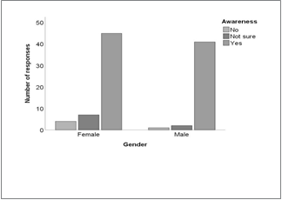
  The risks of improper waste disposal
This study gauged the knowledge associated with improper waste disposal by asking the respondents whether they were aware of improper waste disposal in their community, and the majority of the respondents (n = 74) reported knowing these risks.
The Pearson chi-squared test reveals a statistically insignificant relationship between gender and the awareness of the respondents about improper waste disposal in their community (χ2 = 3.372; df = 2; p = 0.185).
However, most females reported being aware of improper waste disposal risks as compared to their male counterparts (Figure 1).

Slide 31
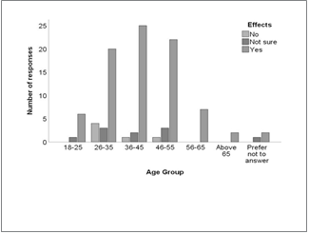
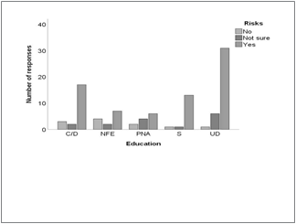
Analysis of Result
The chi-squared test results indicated no significant difference between age group and knowledge of the effects of improper waste disposal (χ2 = 8,893; df = 12; p = 0,712).
However, most of the respondents between the ages 36 and45 (n = 25) answered yes, when asked if they knew of the major effects of improper waste disposal (Figure 2).
The chi-squared test results showed no correlation between the level of education and the knowledge of risk posed by improper waste disposal (χ2 = 13.996; df = 8; p = 0.821). However, most of the respondents with a university degree indicated that they know about the risks posed by improper waste disposal (Figure 3).

Slide 32
Results and Discussion
We investigated the effects of improper waste disposal on the Sobantu community in their district municipality in the KwaZulu Natal Province and found that, indeed, there is a negative effect of the waste disposed improperly to this community. The results of the five chi-squared tests applied showed insignificant relationships when gender, age group, marital status, and employment status of respondents were correlated with several variables that were surprising.

Slide 33
Studies around the world have reported correlations between several demographic variables and the risk of improper waste disposal.
For example, in Akungba-Akoko, Nigeria, respondents’ level of education and age of respondents influenced the responses to the risk of improper waste disposal .
This study is written in the Disaster risk reduction context; therefore, the long-term prospects include positive impacts on policy, public awareness, technological innovation, health outcomes, economic development, and environmental conservation.

Slide 34
Conclusion:
the results from this study indicated that most of the people in Sobantu Township are educated. As a result, the conclusion can be made that somehow poor attitude and negligence of residents add to improper waste disposal witnessed within the study community.
Indeed, indicated that insufficient funds on the side of most governments allocated for waste management, such as waste collection services, ageing or not maintained infrastructure, and inefficient sanitation facilities, are among the factors that escalate improper waste disposal.

Slide 35
Reference:
The impact of improper waste disposal on human health and the environment: a case of Umgungundlovu District in KwaZulu Natal Province, South Africa
Tlou Raphela1*, Nelisiwe Manqele1 and Mariana Erasmus2
1Disaster Management Training and Education Centre for Africa, Faculty of Natural and Agricultural Sciences, University of the Free State, Bloemfontein, South Africa, 2Centre for Mineral Biogeochemistry, Faculty of Natural and Agricultural Sciences, University of the Free State, Bloemfontein, South Africa

